Slide 1


Promoting and strengthening the Universal Periodic Review http://www.upr-info.org
The Follow-up Programme
On the road to implementation
@ Centre international de formation à
l'enseignement des droits de
l'homme et de la paix (CIFEDOP)
25 October 2012

Slide 2
1. UPR Info aims to…
Promote and strengthen the UPR by:
Providing capacity-building tools
Raising awareness

Slide 3
Tools: Website
www.upr-info.org
Explanations, Analyses
Documents
Tutorials

Slide 4
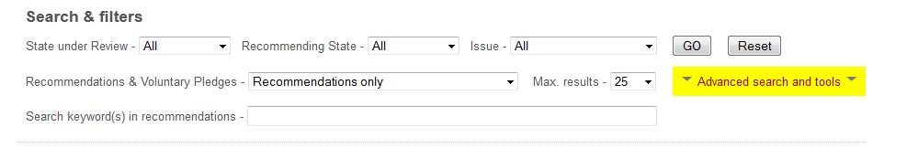
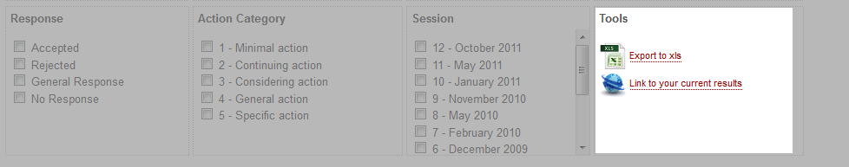
Tools: database

Slide 5
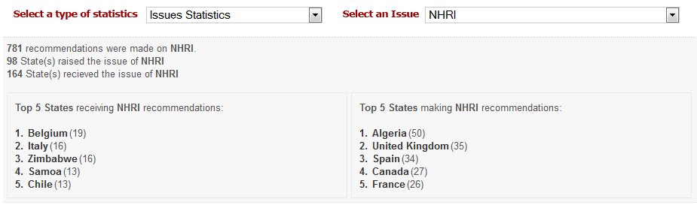
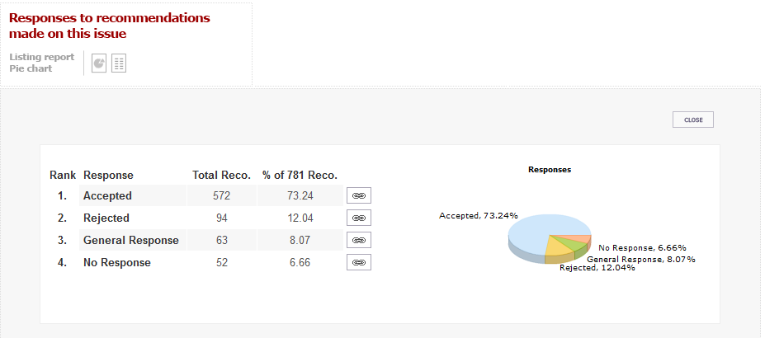
Tools: statistics

Slide 6
Challenges for the second cycle
As SuR, how to handle 280 recommendations?
As recom. State, how to follow up 21’353 recommendations, 139 rec. per rec. State?
How to report on so many recommendations?

Slide 7
Challenges for the second cycle
How to address rejected recommendation and « cases of persistant non-cooperation » (art. 38) ?
How to improve the quality of recommendations (only 35 % specific) ?
Encourage mid-term reporting, and… Follow up.

Slide 8
2. The Follow-up Programme
Started in June 2011
Mid-term
All stakeholders (NGOs, States, UN Agencies)
Mid-term Implementation Assessments
Notes:
3. Stakeholders: UNICEF, UNHCR, UNCT

Slide 9
Follow-up Programme - participation
66 countries
253 NGOs
6 NHRIs
7 States’ mid-term reports
Notes:
And now, some examples of best practices:

Slide 10
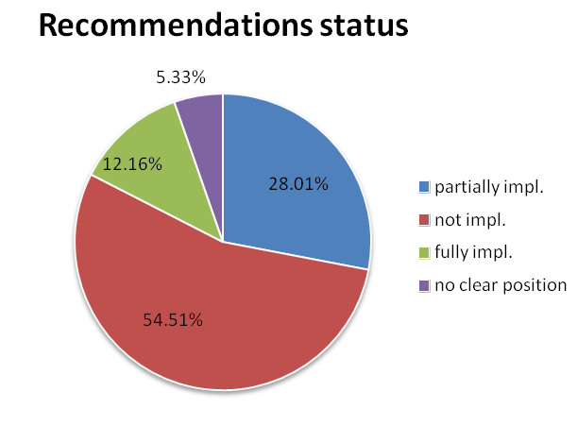
Follow-up Programme - results
6542 recommendations, 3294 recom-mendations commented
40% of recommenda-
tions are implemented
at mid-term!

Slide 11
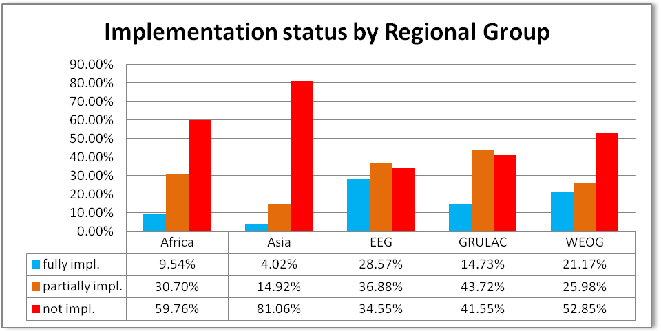
Follow-up Programme – results 2
Where the UPR is successful:

Slide 12
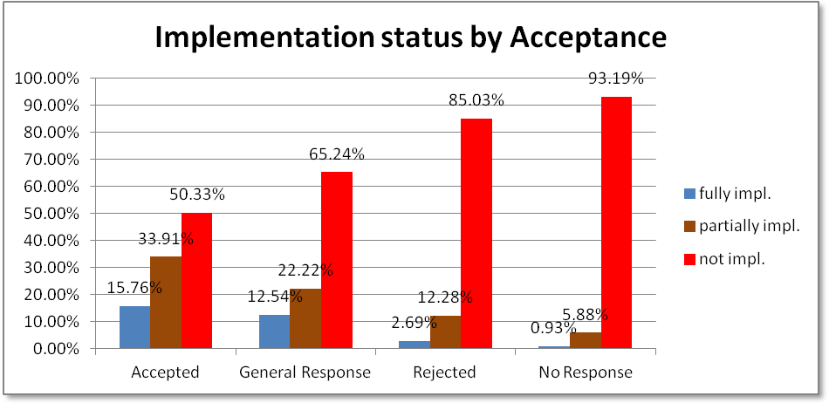
Follow-up Programme – results 3
Acceptance and its role

Slide 13
Follow-up Programme – results 3
Do not focus only on accepted recommendation:
Remains valid, even if rejected
Rejection could become a carte blanche
Rejected recommendation are implemented!
Notes:
Remains a valid concern of the international community. The very same rejected recommendation could be suggested again in the next UPR;
Has to be addressed, since some States rejected over half of recommendations. If we focus only on accepted recommendations, it would be a carte blanche for all States which will be encouraged to reject recommendations in order to avoid any kind of debate;
Action is taken by States with 15 percent of rejected recommendations. It clearly shows that rejecting a recommendation sometimes is only a temporary response.

Slide 14
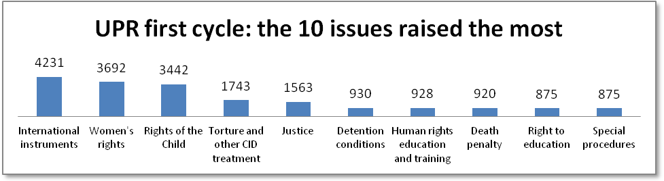
Follow-up Programme – results 4
What issues are raised the most at the UPR?
(1)International Instr., (2) Women and (3)Child

Slide 15
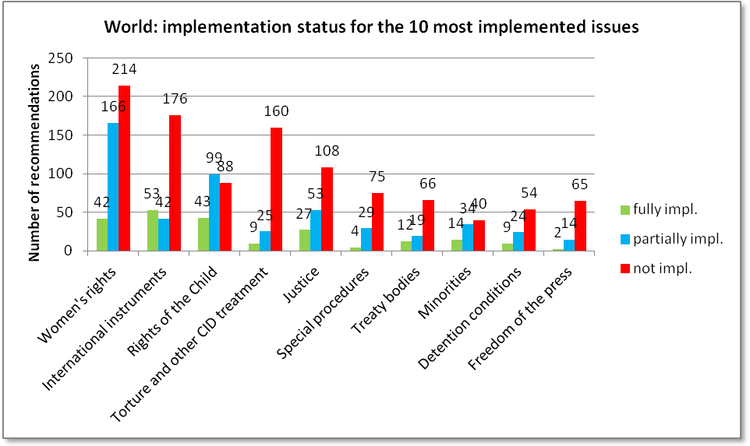
Follow-up Programme – results 4
What are the most implemented issues?

Slide 16
Why to follow up?
Make the State accountable
Involve new civil society actors, build coaltions
Share best practices
Spread the word among citizens

Slide 17
Follow-up outcomes
Main publication: the Mid-term Implementation assessment (MIA)
UPR Info shares the MIAs within the international community
Civil society actors use MIAs as an advocacy tool

Slide 18

Follow-up Programme
How to participate?
If your submitted to OHCHR, we will contact you
If not, please contact us

Slide 19
Follow-up Programme
When to participate? Next deadlines:
Denmark 30.12.2013
Liberia 30.04.2013
Mauritania 30.09.2013
Mongolia 30.04.2013
  More at http://www.upr-info.org/followup

Slide 20
13th session – new cycle
May 2012
437 recommendations from 2008, 373 commented
Many recommendations received in 2008 were reported to be implemented by States

Slide 21
Thank you and good work!
www.upr-info.org
jc.vignoli@upr-info.org

