Slide 1
CIFEDHOP’S 10TH INTERNATIONAL TRAINING SESSION FOR CIVIL SOCIETY AND EDUCATION ORGANISATIONS ON THE HUMAN RIGHTS COUNCIL’S UNIVERSAL PERIODIC REVIEW
UNIVERSAL PERIODIC REVIEW
EXPERIENCES FROM SIERRA LEONE
By
Francess Alghali
Former Executive Secretary
Human Rights Commission of Sierra Leone

Slide 2
1ST CYCLE UPR FOR
SIERRA LEONE
Sierra Leone was reviewed under the UPR on the 5th May 2011, and the final report was adopted by the Human Rights Council at its 18th session on the 22nd September 2011. The report included a total of 129 recommendations to the Government of Sierra Leone. The Government accepted 126, with the sole exception of those relating to gender identity and orientation. Among the recommendations accepted, the Government indicated that 57 were already implemented or were under implementation, 54 were accepted and 15 were accepted subject to the constitutional review process.

Slide 3
NATIONAL CONFERENCE
Objectives of the National Conference
To provide feedback and create full awareness on the entire UPR review process.
To agree on actions, roadmap and strategies for the implementation of UPR recommendations.
To link the UPR outcomes with other government processes in the country.
To cultivate strong stakeholder commitment to the effective implementation of the recommendations.

Slide 4
OUTCOMES OF NATIONAL CONFERENCE
Conference Communiqué
Resolution for a Mid-Term Review
Thematic Classification of Recommendations

Slide 5
MID-TERM REVIEW
National Mid-Term Review Conference organized 5th and 6th September 2013 by the HRCSL together with the AG&MJ and the MFAIC
to assess the status of implementation of the UPR recommendations
take note of the progress and reinvigorate the stakeholders’ commitment to the UPR process and build consensus on the way forward for the next two years

Slide 6
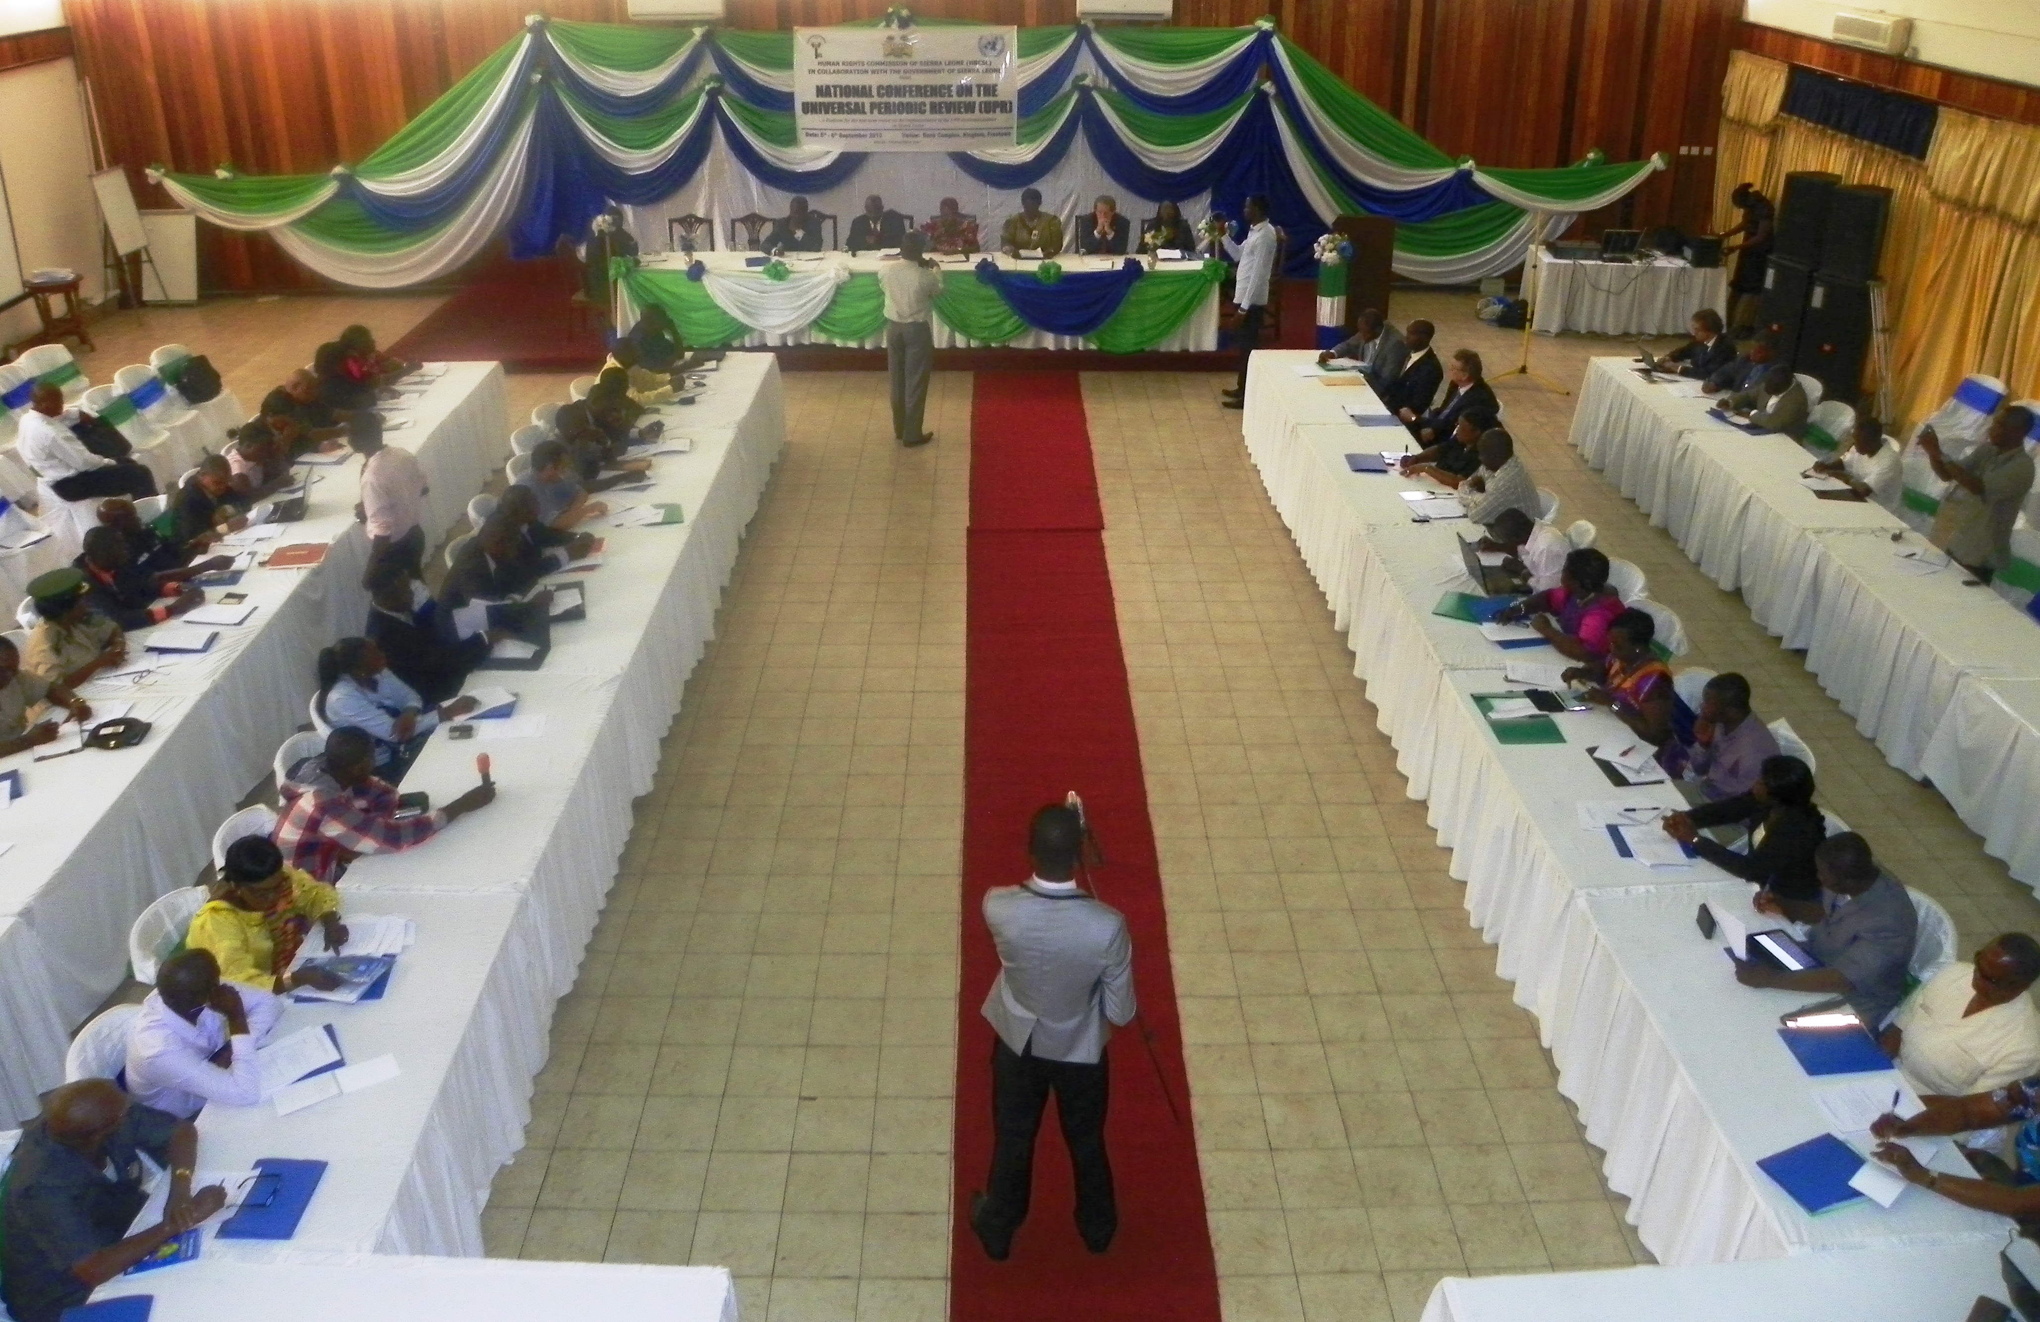
REVIEW CONFERENCE

Slide 7
NATIONAL MID-TERM REVIW
THEMATIC AREAS/CLASSIFICATION
(i) Treaty Ratification, Treaty Body Reporting and Interaction with UN Human Rights Mechanism
(ii) Constitutional and Legal Reforms: incorporating Human Rights Standards into Domestic Law
(iii) Strategies to Address the Human Rights of Women and Children including Policy Formulation
(iv) Measures and Institutional Mechanisms for Economic, Social and Cultural Rights, Poverty Reduction and Sustainable Development
(v) Recommendations already implemented or under implementation.

Slide 8
Treaty Ratification, Treaty Body Reporting and Interaction with UN Human Rights Mechanism (12)
Recommendation [in bracket the number of the relevant recommendations as per the Final UPR Report adopted by the HRC in September 2011] | Government Position | Lead Ministry | Progress and Status If Progress Achieved: How? | (Further) Action Required, Including Monitoring of Progress
Sign/ratify Optional Protocol to the Convention against Torture and Other Cruel, Inhuman or Degrading Treatment or Punishment (OP-CAT) [80.1, 80.3, 80.4, 80.5][82.1] | Accepted | MFAIC AG&MJ | Signed (check date). Awaiting Cabinet approval for ratification | AG&MJ to review existing domestic legislation for compliance with OP-CAT, and prepare bill Parliament to ratify MFAIC to submit ratification instrument to UN
2. Ratify Optional Protocol to the Convention on the Elimination of All Forms of Discrimination against Women (OP-CEDAW) as well as the Optional Protocol to the African Charter on the Rights of Women [80.1, 80.2, 80.6, 80.7] [82.1] | Accepted | MFAIC MSWGCA | Signed (08/09/2000) but not ratified. The MSWGCA has put the OP-CEDAW on its work plan to pursue its ratification by 2014. | MSWGCA & AG&MJ to review existing domestic legislation for compliance with OP and prepare bill Parliament to ratify MFAIC to submit ratification instrument to UN

Slide 9
CONSTITUTIONAL AND LEGAL REFORM: INCORPORATING HUMAN RIGHTS STANDARDS INTO DOMESTIC LAW (16)
Recommendation [in bracket the number of the relevant recommendations as per the Final UPR Report adopted by the HRC in September 2011] | Government Position | Lead Ministry | Progress and Status If Progress Achieved: How? | (Further) Action Required, Including Monitoring of Progress
Take measures and establish strategies to prevent women and girls from suffering from harmful traditional practices such as early/forced marriages, teenage pregnancies and FGM [80.18, 80.20] [82.12] | Accepted 82.12 accepted with a call for technical assistance | MSWGCA | The issue of FGM is culturally ingrained in our society. The GoSL intend to use the enactment of law against underage initiation rites of passage for girls as the entry point. On the issue of early/forced marriages and teenage pregnancy, government enacted the Child Rights Act 2007 to address some of these issues. Additionally, government has developed and launched a National Strategy for the reduction of teenage pregnancy in Sierra Leone (2013-2015). The Ministry of Social Welfare, Gender and Children’s Affairs is in the process of finalizing the National Child and Family Welfare Policy which will contribute immensely in addressing these menaces. | LRC to streamline of the contradiction on minimum age for marriage between the Child Rights Act (18 years old) and the Customary Marriage Act (below 18 years old with consent) in favour of the provisions of the Child Rights Act.

Slide 10
MEASURES AND INSTITUTIONAL MECHANISMS ON ECONOMIC, SOCIAL AND CULTURAL RIGHTS, POVERTY REDUCTION (5)
Recommendation [in bracket the number of the relevant recommendations as per the Final UPR Report adopted by the HRC in September 2011] | Government Position | Lead Ministry | Progress and Status If Progress Achieved: How? | (Further) Action Required, Including Monitoring of Progress
Increase the annual budget as well as set up mechanisms to investigate ways to improve education management and teaching methods. Also incorporate human rights education and training into the school curriculum [81.51, 81.53] [82.27] | Accepted 81.51 was declared under implementation | MOFED MEST TEC | The education envelope increased in the period 2004 to 2012 from Le 247 billion to Le 407 billion. In the period 2010 to 2012, the envelope increased from Le 337 billion to Le 407 billion corresponding to increase from 26% of domestically generated resources to 28%. A new GoSL Education Sector Plan (ESP) has just been prepared and endorsed by development partners in education. One of the 3 main areas covered by the ESP is ‘system strengthening’. Strategies and activities to improve education management in the period 2014 to 2018 are detailed under ‘system strengthening’. The implementation plan derived from the ESP spells out how education management is to be improved. | Ensure that the review of education management and teaching methods include plans for the tertiary education.

Slide 11
RECOMMENDATIONS ALREADY IMPLEMENTED OR UNDER IMPLEMENTATION (24)
Recommendation [in bracket the number of the relevant recommendations as per the Final UPR Report adopted by the HRC in September 2011] | Government Position | Lead Ministry | Progress and Status If Progress Achieved: How? | (Further) Action Required, Including Monitoring of Progress
Set up the TRC follow up committee and task it to monitor and track progress in the implementation of the TRC recommendations [81.5, 81.6] | MFAIC | No progress | GoSL to speedily establish the TRC Follow-up Committee

Slide 12
ASSESMENT
Specificity
E.g. Enact the Freedom of Information bill, and repeal laws that that provide criminal penalties for libel
Vagueness
E.g Examine the possibility of ratifying the International Convention on the Protection of the Rights of All Migrant Workers and Members of Their Families (ICRMW), the International Convention for the Protection of All Persons from Enforced Disappearance and the Optional Protocol to the International Convention on the Elimination of All Forms of Discrimination against Women
Process
E.g Consider instituting a human rights training programme specifically for its army and police forces

Slide 13
CURRENT STATUS OF IMPLEMENTATION
40 % - 50%
????????

Slide 14
PREPARATION FOR THE UPR 2ND CYCLE FOR SIERRA LEONE

Slide 15
TRAINING FOR COMMISSIONERS AND STAFF ON THE UPR PROCESS
SETTING UP OF A UPR STEERING COMMITTEE TO FACILITATE, COORDINATE AND COMPILE INFORMATION FOR THE PREPARATION OF THE STAKE HOLDER REPORT
REGIONAL CONSULTATIONS

Slide 16
Set up a 3-man drafting team to collate all the information obtained from consultations including SOHR reports since 2011 and prepare a draft report
Validation Workshop to conclude the report
Provision of Technical Support to Stakeholders

Slide 17
SUPPORT TO CIVIL SOCIETY
CONDUCTED TRAINING IN COLLABORATION WITH AMNESTY INTERNATIONAL ON THE PREPARATION OF STAKEHOLDERS REPORT
SERVED AS FACILITATORS FOR CIVIL SOCIETY CONSULTATIONS

Slide 18
Challenges
Lack of capacity to engage with the process
(knowledge, information, funding)
Polarization of civil society

Slide 19
Support to Government
Provision of information
Served as Facilitators for Consultations
Participated in the Consultations and Validation of the Report

Slide 20
CHALLENGES
Lack of capacity to engage with the process
Perception of the process (event vs. continuous process)
Competing priorities
Capacity of the NHRI to provide support

Slide 21
☺ ♥
THANKS FOR LISTENING
???????????????

